Slide 1





SchizConnect Work-in-Progress:
Data Mediation, BIDSification and Pipelines for Neuroimaging Research in Schizophrenia
Lei Wang
Big Data Neuroscience 2017 Workshop
September 8, 2017
Bloomington, IN

Slide 2
Outline
Why do we need SchizConnect
What is SchizConnect & how SchizConnect works
What is SchizConnect being used for
What’s new at SchizConnect

Slide 3
Why do we need SchizConnect
Variability & heterogeneity in schizophrenia
  Clinical, behavioral, cognitive, neurobiological & genetic variability
Reproducible research
  Sample size & sampling, cohort biases
  Image processing/analysis methods
Meta analysis
  Often restricted to common effects: age, gender
Mega analysis
  Access individual level data, mediation models
  Reproducibility & new discovery

Slide 4
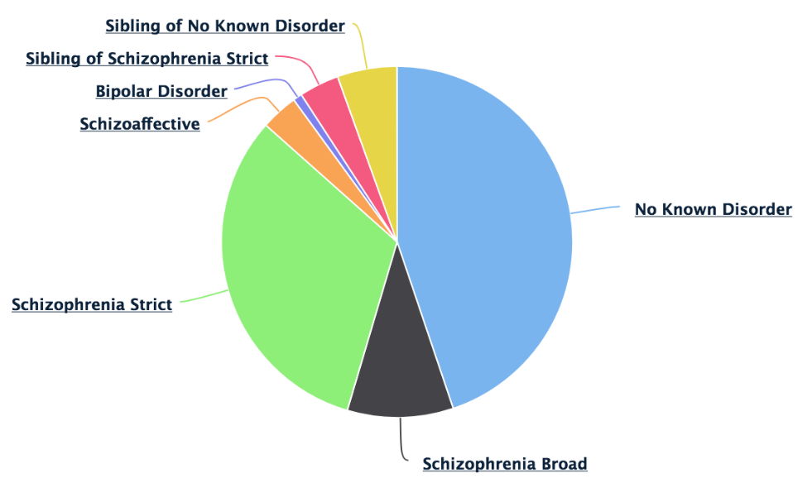
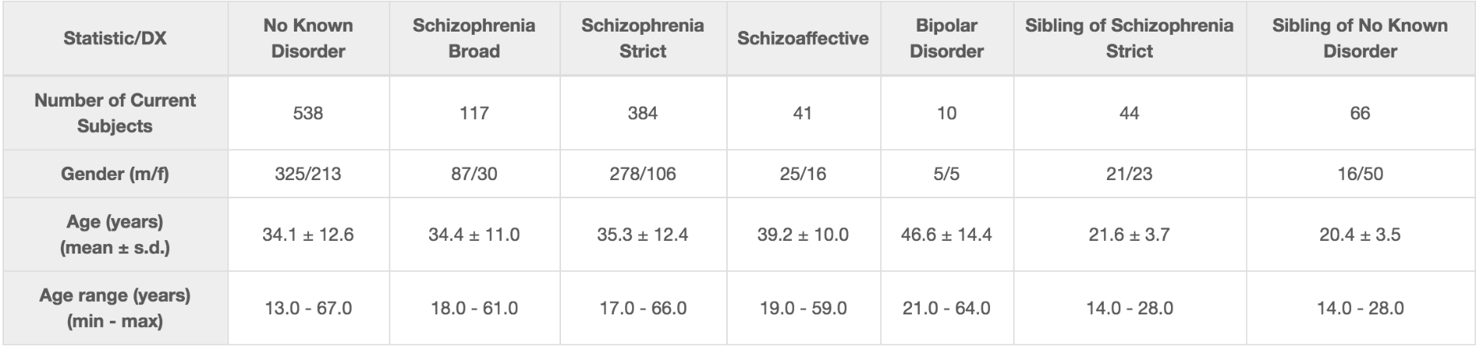
What is SchizConnect
1200 subjects: schizophrenia, schizoaffect, bipolar, siblings
T1, T2, DTI, resting-state fMRI, task fMRI
Cognition tests
Clinical assessments

Slide 5
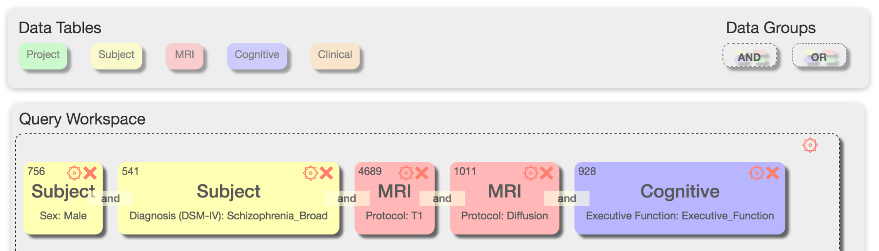
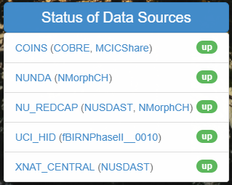



What is SchizConnect
Virtual neuroimaging database on schizophrenia and related disorders
Mediator
Central
http://schizconnect.org/
●●●
Web Portal
Data Warehouse
Mediator Interface
Data Source Interface

Slide 6
What is SchizConnect
Males with Schizophrenia, both a DTI and a T1 scan, and measures of Executive Function
Subjects with 3T T1 and Resting-State scans, who have measures of Functional Capacity (UPSA) and Executive Function
Subjects with a T1 scan and demographic data
Subjects with both a Working Memory task scan and a T1 scan, who have measures of Verbal Episodic Memory and Verbal Working Memory

Slide 7
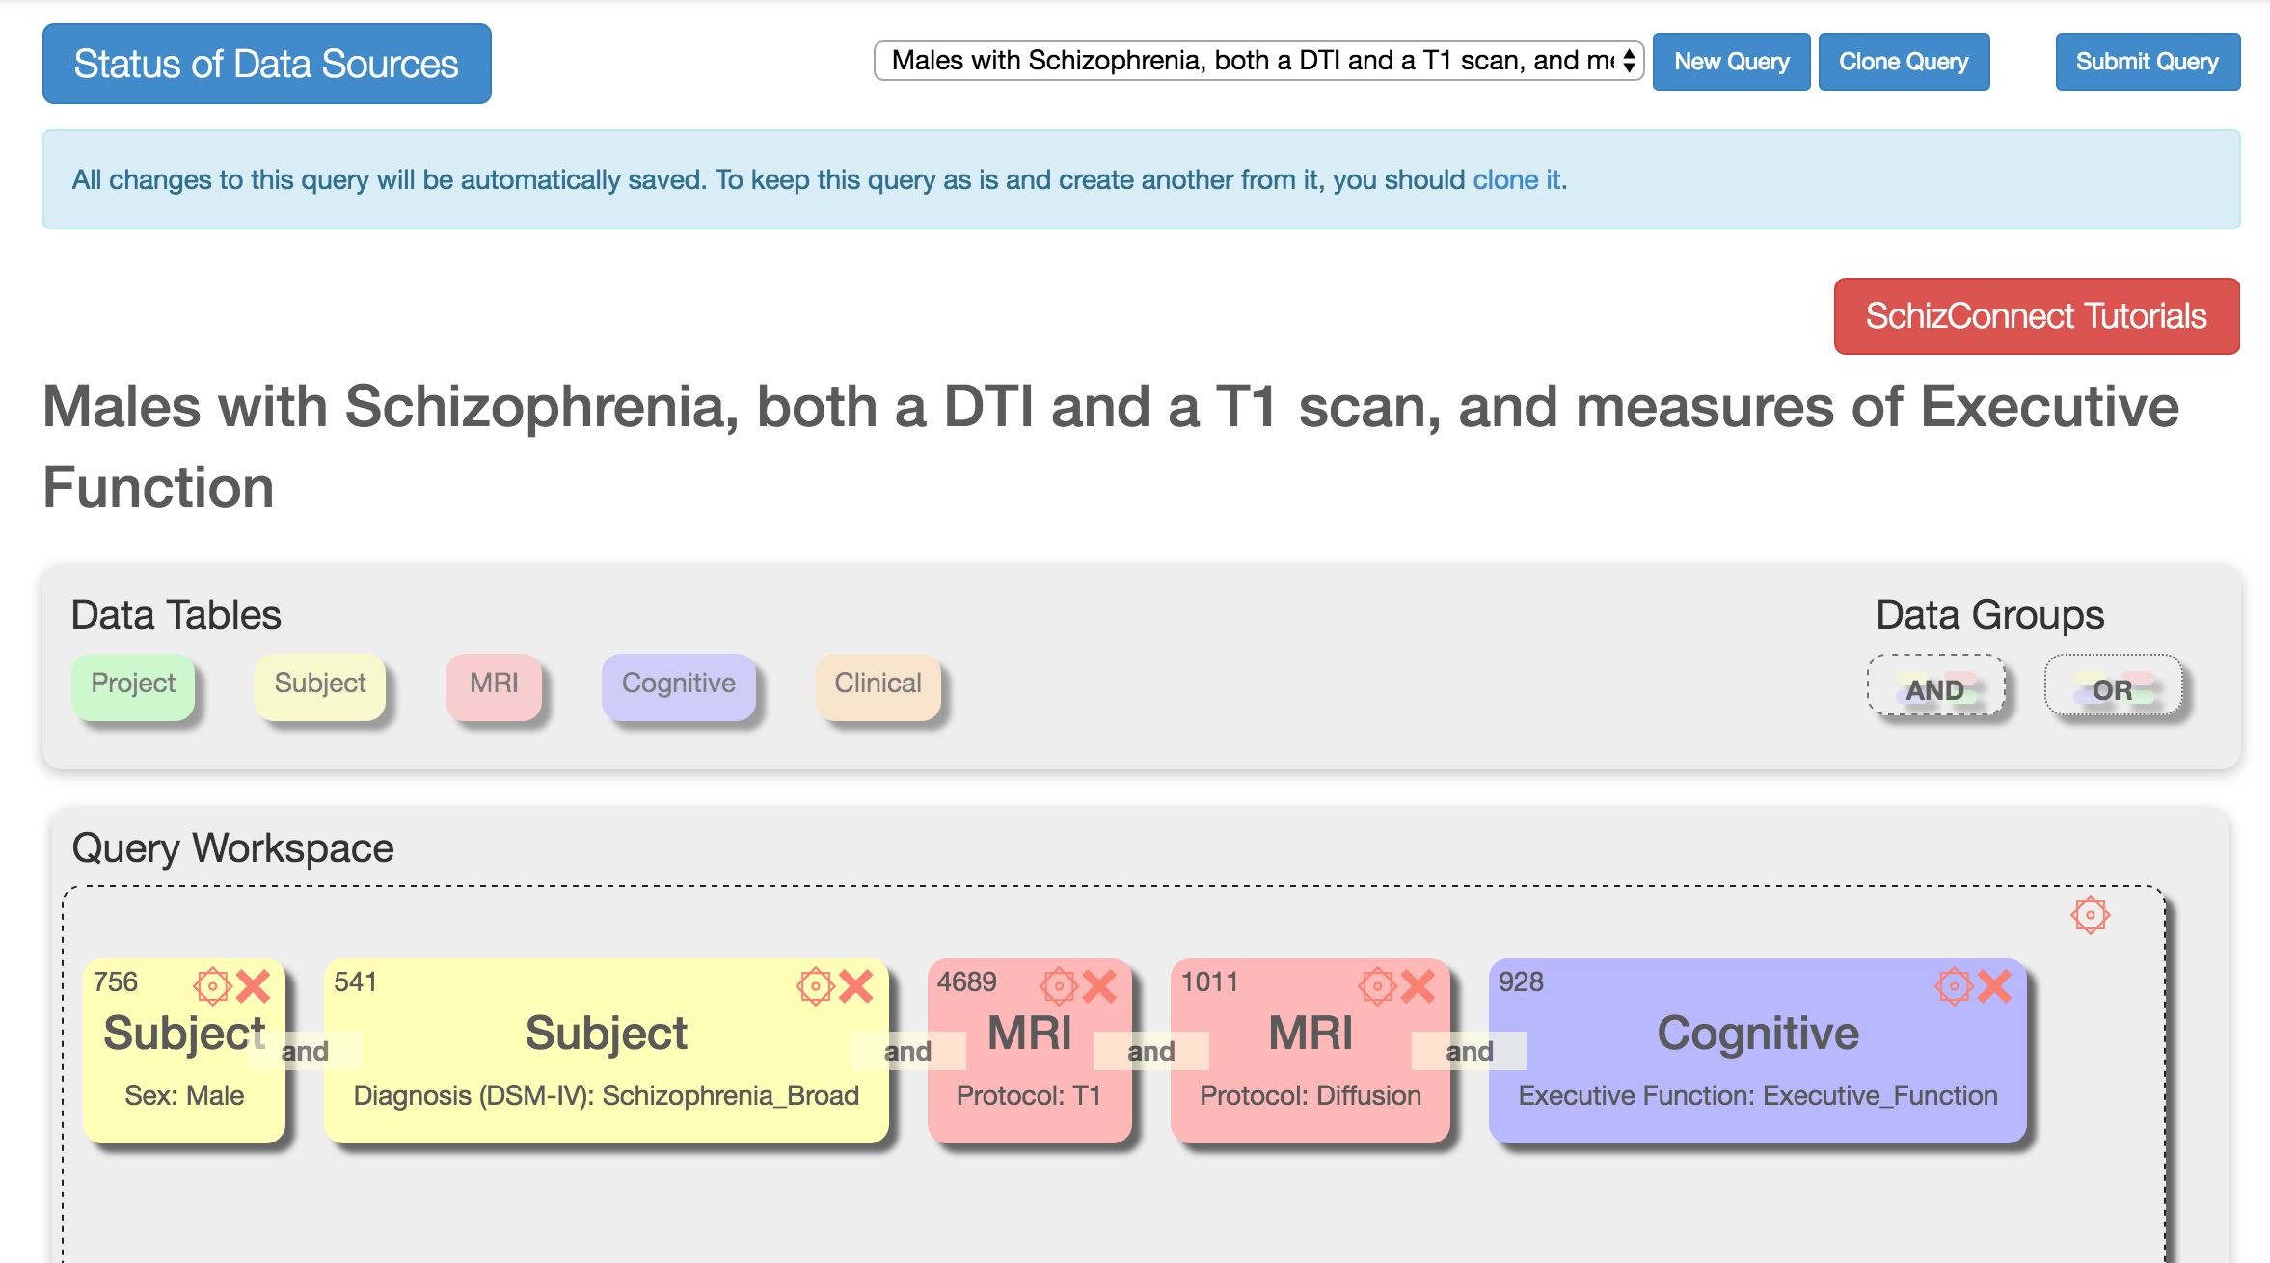
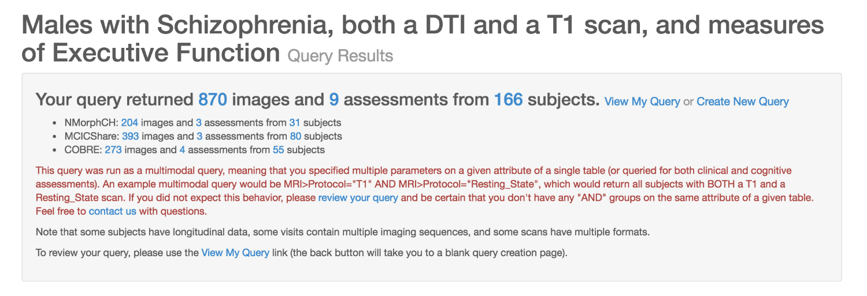
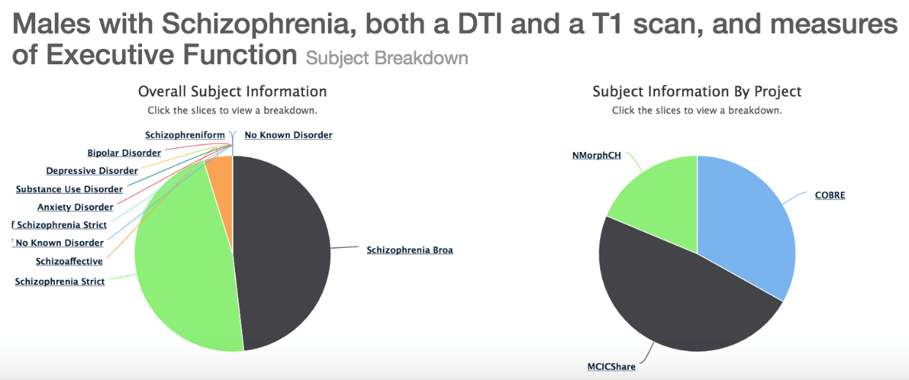
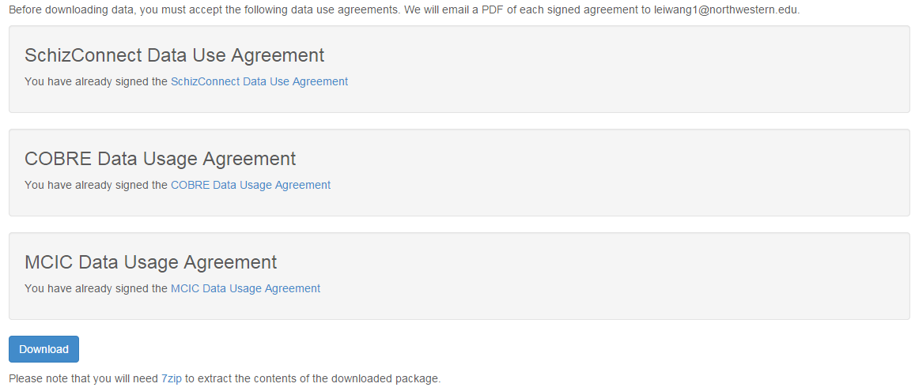
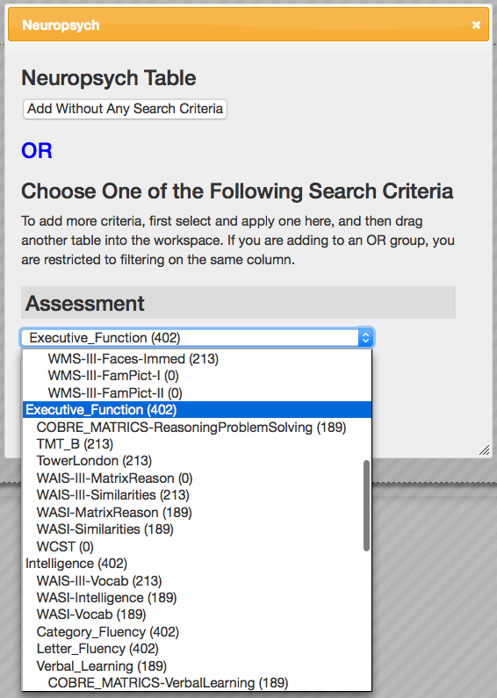
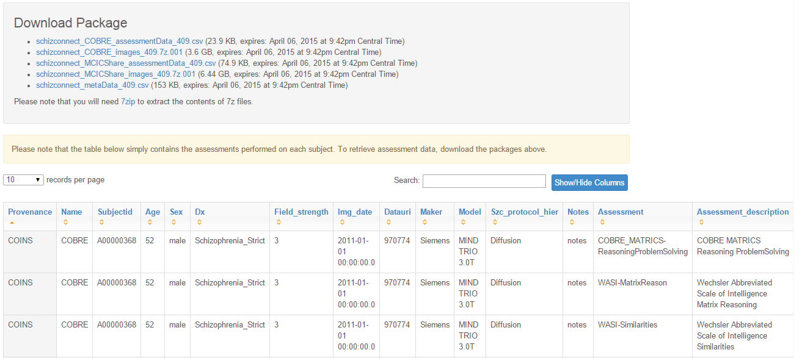
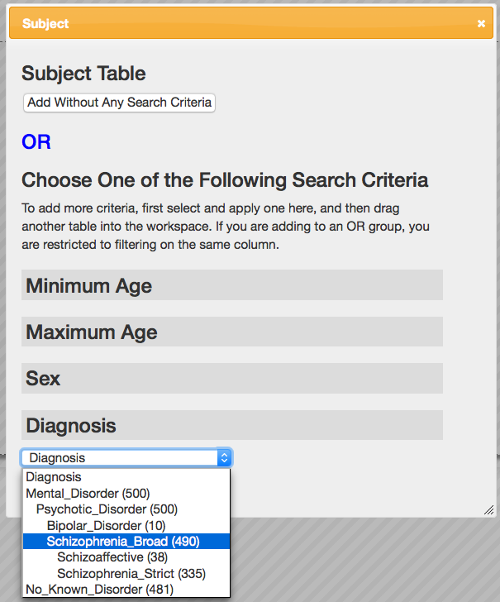
Males with Schizophrenia, both a DTI and a T1 scan, and measures of Executive Function

Slide 8
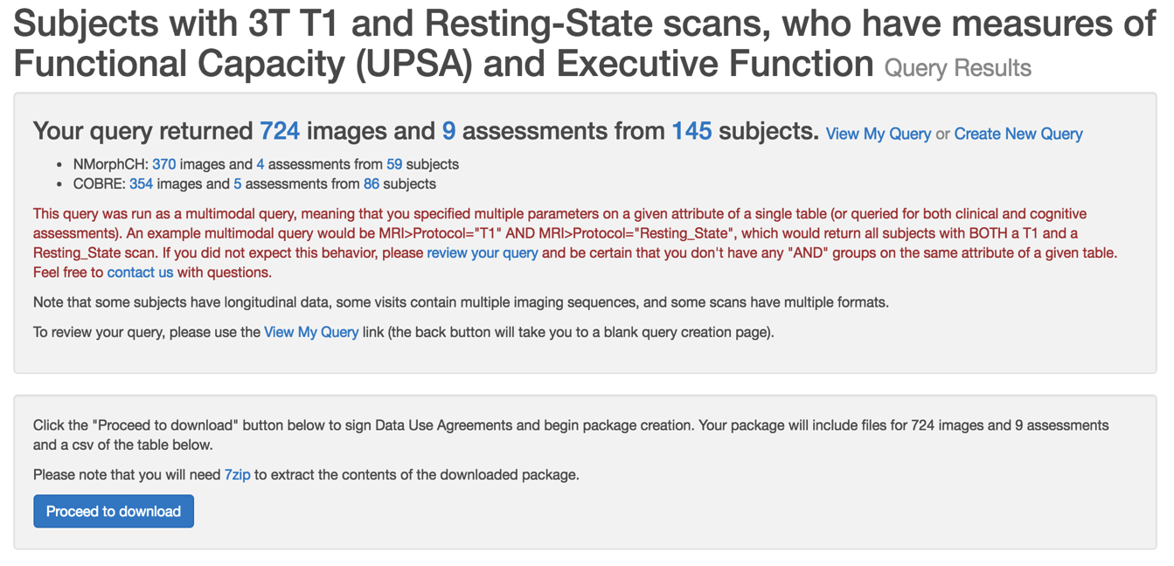
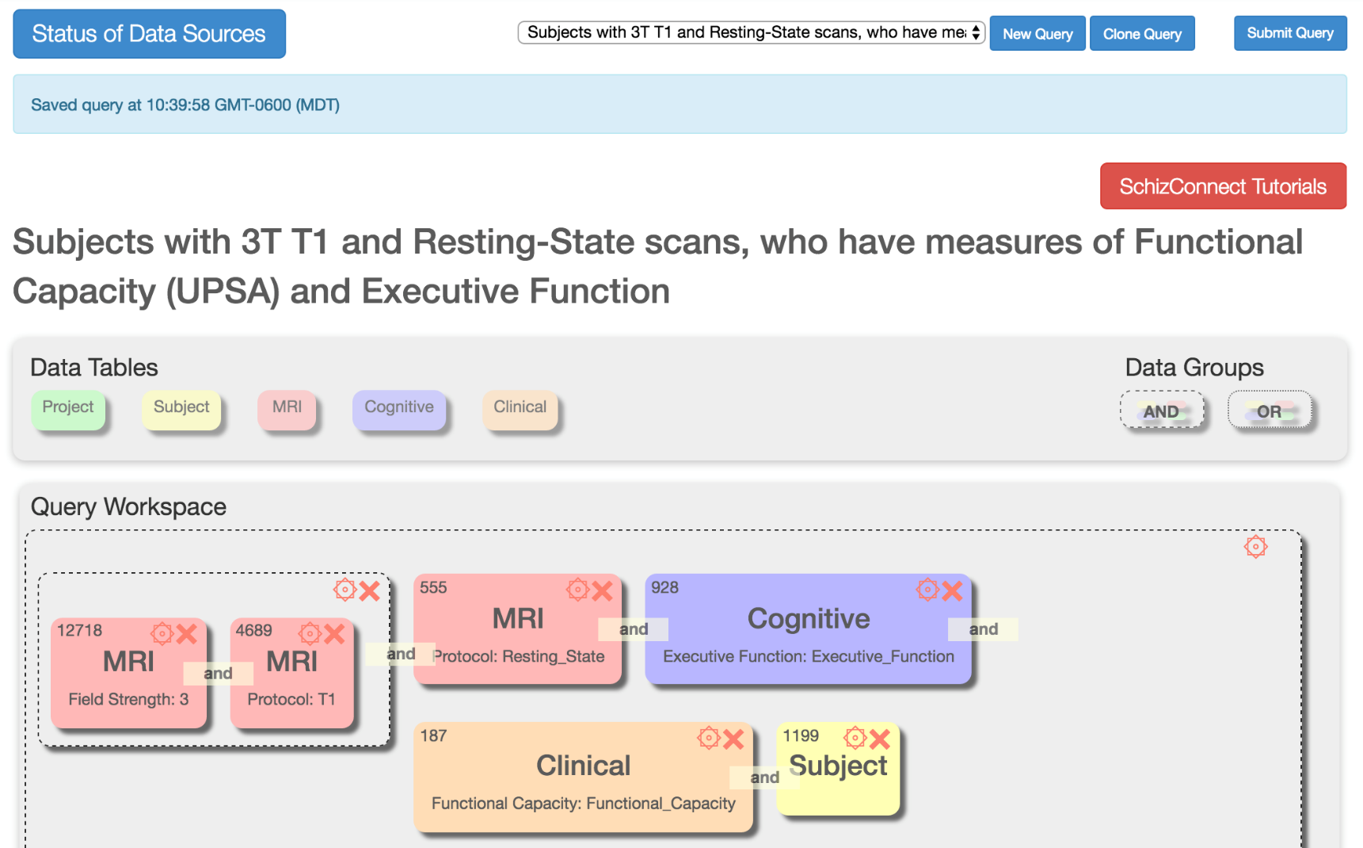
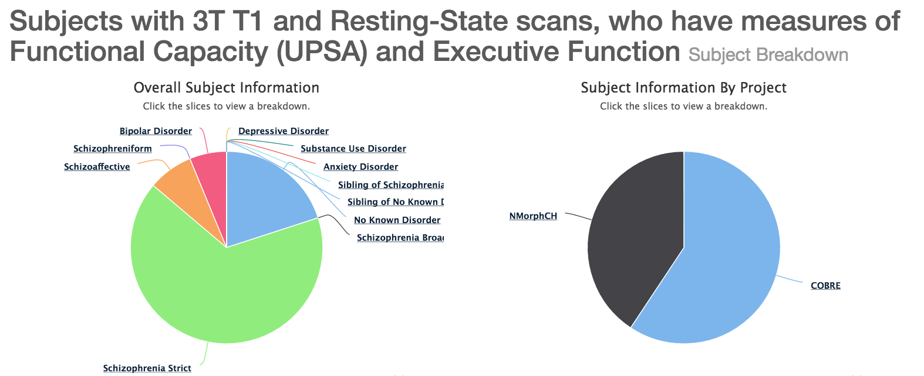
Subjects with 3T T1 and Resting-State scans, who have measures of Functional Capacity (UPSA) and Executive Function

Slide 9
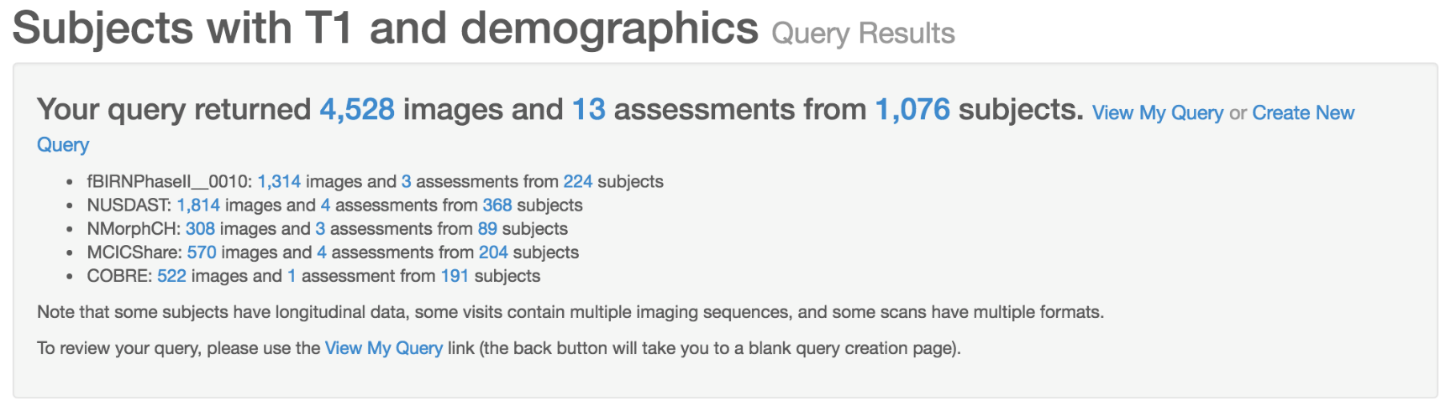
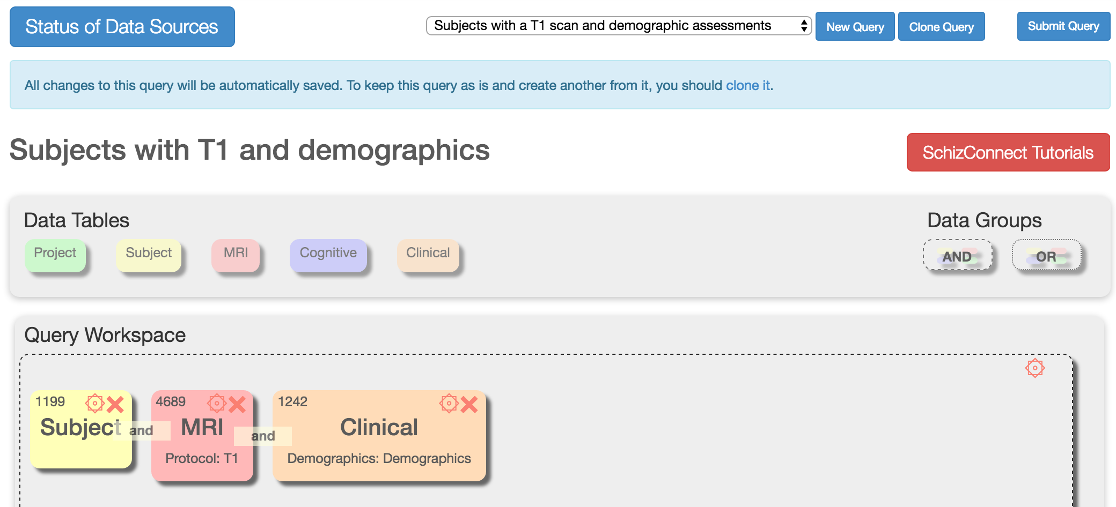
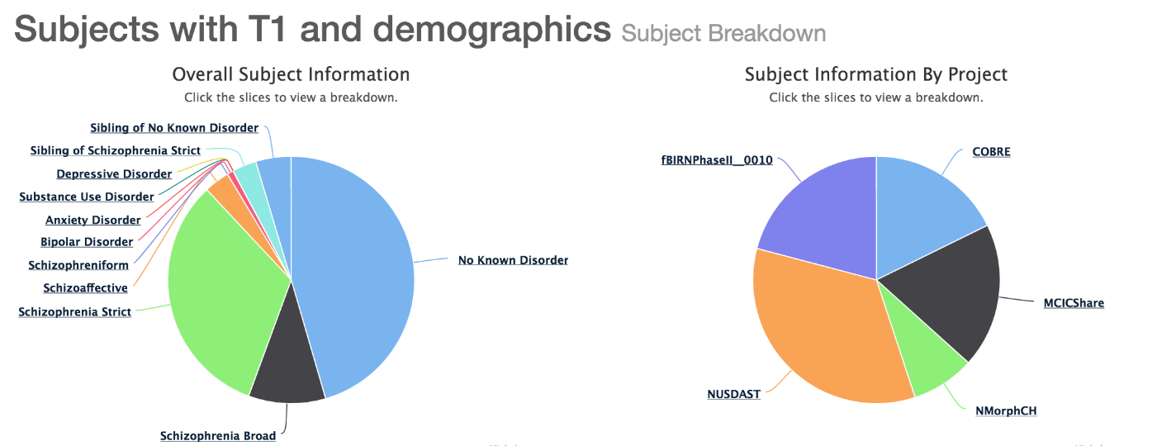
Subjects with a T1 scan and demographic data

Slide 10
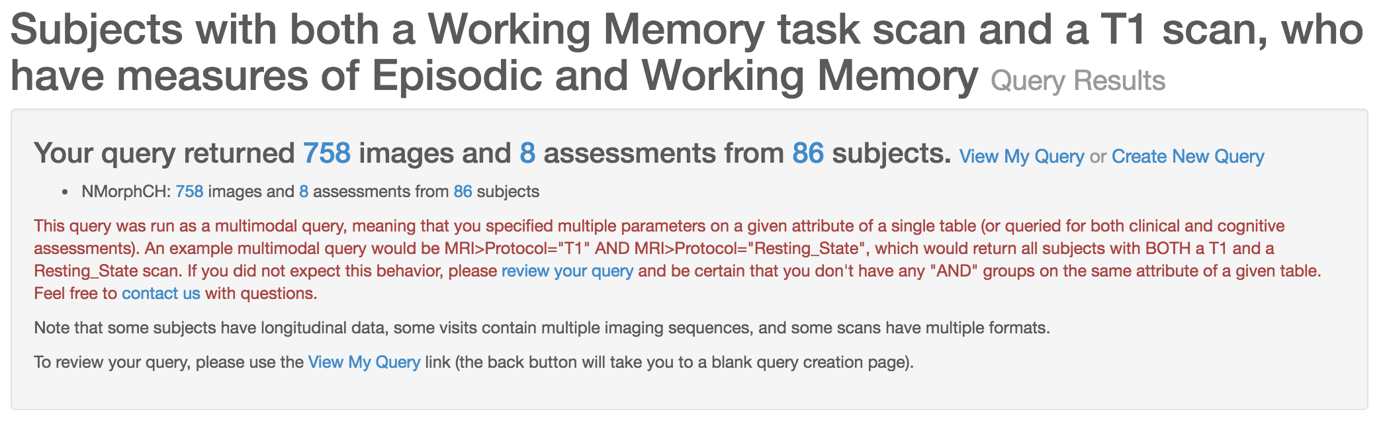
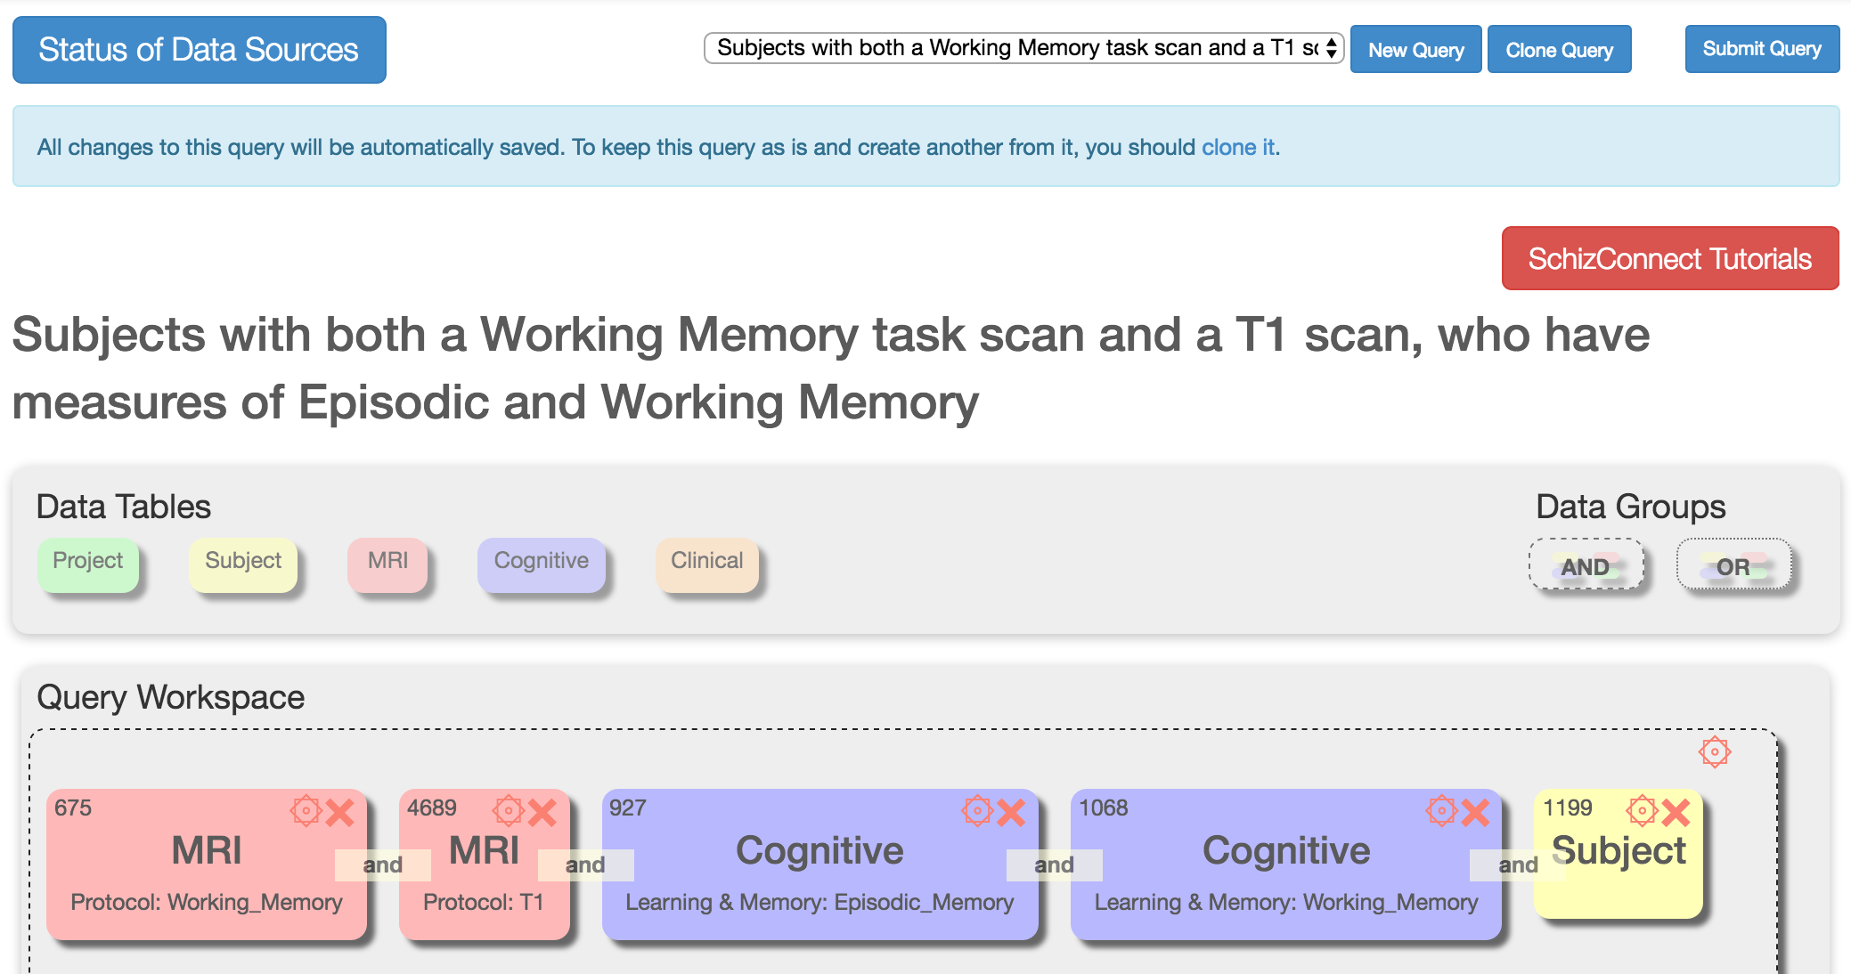
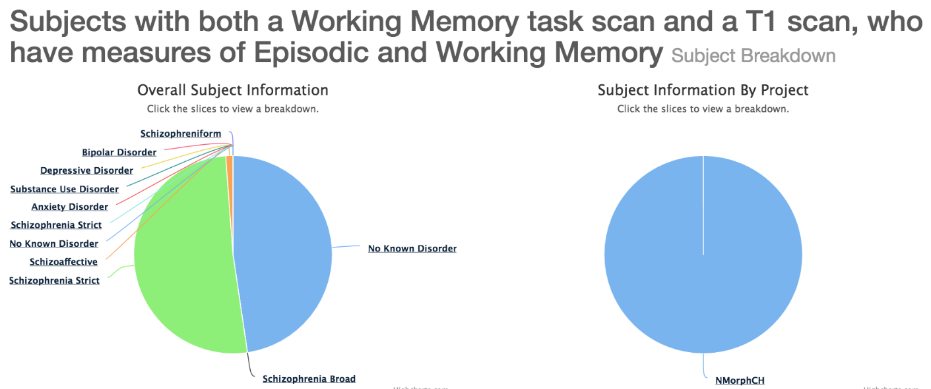
Subjects with both a Working Memory task scan and a T1 scan, who have measures of Episodic and Working Memory

Slide 11
How does SchizConnect work
Virtual neuroimaging database
Data mediation with schema mapping
Mediator
Query rewriting
Common schemas
Central
Schema mapping
Source schemas
http://schizconnect.org/
●●●
Web Portal
Data Warehouse
Mediator Interface
Data Source Interface

Slide 12
How does SchizConnect work
Common schema for imaging data
Field
Strength
T1
Make
Structural
T2
Model
MRI
Perfusion
Diffusion
Imaging Protocol
Field Mapping
Resting State
Functional
Task Paradigm

Slide 13
How does SchizConnect work
Common schema for imaging data – Structural
Source |  | Protocol
HID | T1 | t1;"t1"
HID | T1 | t1_deface;"t1_deface"
HID | T2 | t2;"t2"
HID | T2 | T2 Inplane Scan;"T2 Inplane Scan"
NUSDAST | T1 | FLASH1 type="T1"
NUSDAST | T1 | MPR1 type="T1"
NUSDAST | T1 | MPR2 type="T1"
NUSDAST | T1 | MPR3 type="T1"
NUSDAST | T1 | MPR4 type="T1"
NUSDAST | T1 | MPR5 type="T1"
NUSDAST | T1 | MPR6 type="T1"
NUSDAST | T1 | FLASH3D
NUSDAST | T1 | MPRAGE

Slide 14
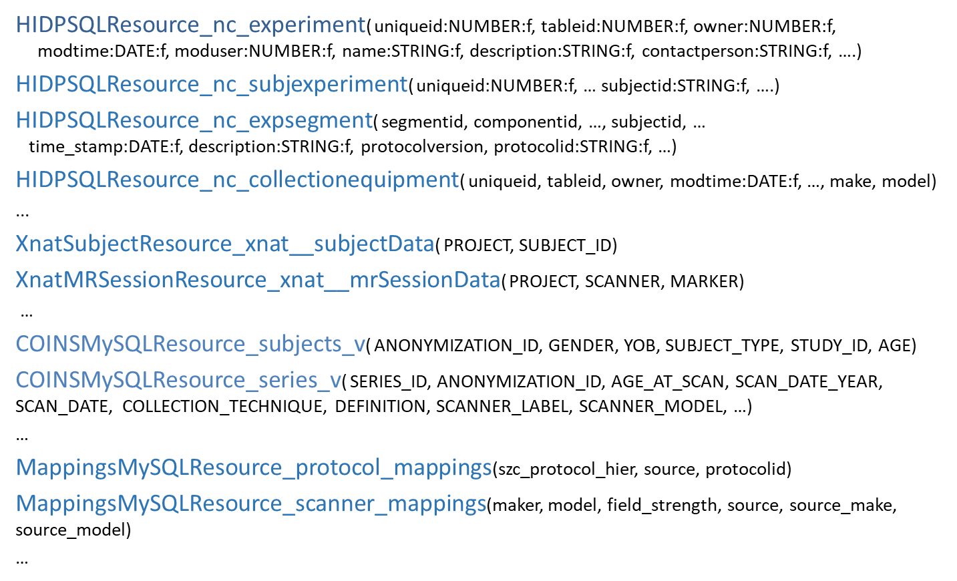
How does SchizConnect work
Source schema

Slide 15
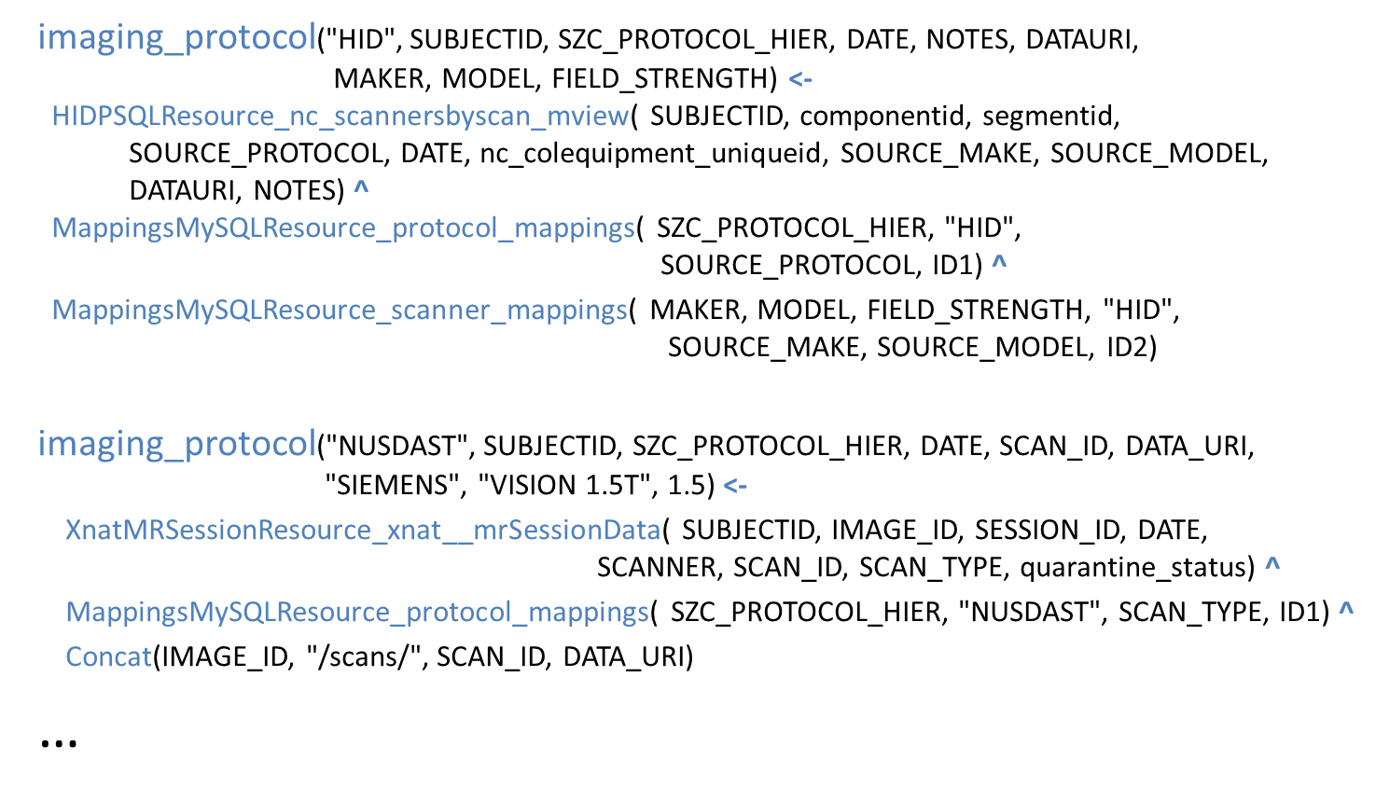
How does SchizConnect work
Schema mapping

Slide 16
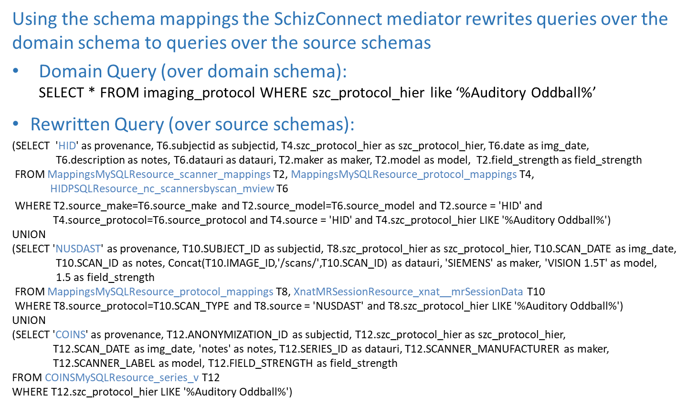
How does SchizConnect work
Query rewriting

Slide 17
How does SchizConnect work
Depression/ Mood
Schema for clinical data
Demographics
Insight
Symptoms-Psychopathology
Clinical
Positive/ Negative Symptoms
Symptoms-Extrapyramidal
Psychopathology
Functional Capacity
Suicide Ideation
Medical
Personality

Slide 18
How does SchizConnect work
Schema for clinical data – Psychopathology
Source | Test
NUSDAST | SIPS | Structured Interview for Prodromal Syndromes Summary
NMorphCH | SIPS | Structured Interview for Prodromal Syndromes Summary
ConteTT | SIPS | Structured Interview for Prodromal Syndromes Summary
COBRE | PANSS | Positive and Negative Symptom Scale
BrainGluSchi | PANSS | Positive and Negative Symptom Scale
fBIRN PhaseII | Modified Positive and Negative Symptom Scale | Positive and Negative Symptom Scale
fBIRN PhaseIII | PANSS | Positive and Negative Symptom Scale
MCIC | SAPS | Scale for the Assessment of Positive Symptoms
fBIRN PhaseII | SAPS | Scale for the Assessment of Positive Symptoms
fBIRN PhaseIII | SAPS_PhaseIII | Scale for the Assessment of Positive Symptoms
NUSDAST | SAPS SANS | Scale for the Assessment of Positive Symptoms
NMorphCH | SAPS SANS | Scale for the Assessment of Positive Symptoms
ConteTT | SAPS SANS | Scale for the Assessment of Positive Symptoms
MCIC | SANS | Scale for the Assessment of Negative Symptoms
fBIRN PhaseII | SANS | Scale for the Assessment of Negative Symptoms
fBIRfBIRN PhaseIII | SANS_PhaseIII | Scale for the Assessment of Negative Symptoms
NUSDAST | SAPS SANS | Scale for the Assessment of Negative Symptoms
NMorphCH | SAPS SANS | Scale for the Assessment of Negative Symptoms
ConteTT | SAPS SANS | Scale for the Assessment of Negative Symptoms
fBIRN PhaseIII | NSA-4 | Negative Symptom Assessment
fBIRN PhaseII | Deficit Syndrom ScoreSheet | Deficit Syndrome Score Sheet
fBIRN PhaseIII | Schedule of Deficit Syndrome Scale | Schedule of Deficit Syndrome Scale
fBIRN PhaseII | Hallucination | Hallucination
fBIRN PhaseII | Calgary Depression Scale | Calgary Depression Scale
fBIRN PhaseIII | Calgary Depression Index | Calgary Depression Scale
COBRE | CAL | Calgary Depression Scale
BrainGluSchi | CAL | Calgary Depression Scale
fBIRN PhaseII | quick mood scale | Quick Mood Scale
COBRE | YMRS | Young Mania Scale
BrainGluSchi | YMRS | Young Mania Scale
BrainGluSchi | Schizo-Bipolar Scale | Schizo-Bipolar Scale
fBIRN PhaseII | InterSePT | InterSePT Scale for Suicidal Thinking
NUSDAST | Lifetime Psychopathology | Lifetime Psychopathology
NMorphCH | Lifetime Psychopathology | Lifetime Psychopathology
ConteTT | Lifetime Psychopathology | Lifetime Psychopathology
NUSDAST | BPRS Form | Brief Psychiatric Rating Scale
NUSDAST | Chapman | Chapman Psychosis Proneness Scales
ConteTT | Chapman | Chapman Psychosis Proneness Scales
NUSDAST | SUMD | Scale to Assess Unawareness of Mental Disorder
NUSDAST | MADRS | Montgomery-Asberg Depression Rating Scale
NMorphCH | MADRS | Montgomery-Asberg Depression Rating Scale
ConteTT | MADRS | Montgomery-Asberg Depression Rating Scale

Slide 19
How does SchizConnect work
Schema for cognitive data
Verbal Learning
Attention
Premorbid Functioning
Learning
Visual Learning
Executive Function
Processing Speed
Verbal Working Memory
Intelligence
Learning & Memory
Working Memory
Cognition
Visual Working Memory
Language
Social Cognition
Verbal Episodic Memory
Motor
Visuospatial
Episodic Memory
Visual Episodic Memory

Slide 20
How does SchizConnect work
Schema for cognitive data – Attention
Source | Test
MCICShare | CalCap | California Computerized Assessment Package
NUSDAST | CPT-AX | A-X Continuous Performance Test - context version
NMorphCH | CPT-AX | A-X Continuous Performance Test - context version
ConteTT | CPT-AX | A-X Continuous Performance Test - context version
COBRE | CPT-II | Conners' Continuous Performance Test-II
COBRE | CPT-IP | Continuous Performance Test - Identical Pairs version
fBIRN PhaseIII | CPT CMINDS | Continuous Performance Test - Identical Pairs version
NMorphCH | CPT-IP | Continuous Performance Test - Identical Pairs version
BrainGluSchi | CPT-IP | Continuous Performance Test - Identical Pairs version
ConteTT | CPT-IP | Continuous Performance Test - Identical Pairs version
BrainGluSchi | MATRICS Attention_Vigilance | MATRICS Consensus Cognitive Battery (MCCB) Attention Vigilance
COBRE | MATRICS Attention_Vigilance | MATRICS Consensus Cognitive Battery (MCCB) Attention Vigilance
fBIRN PhaseIII | Stroop Test CMINDS | Stroop Test

Slide 21
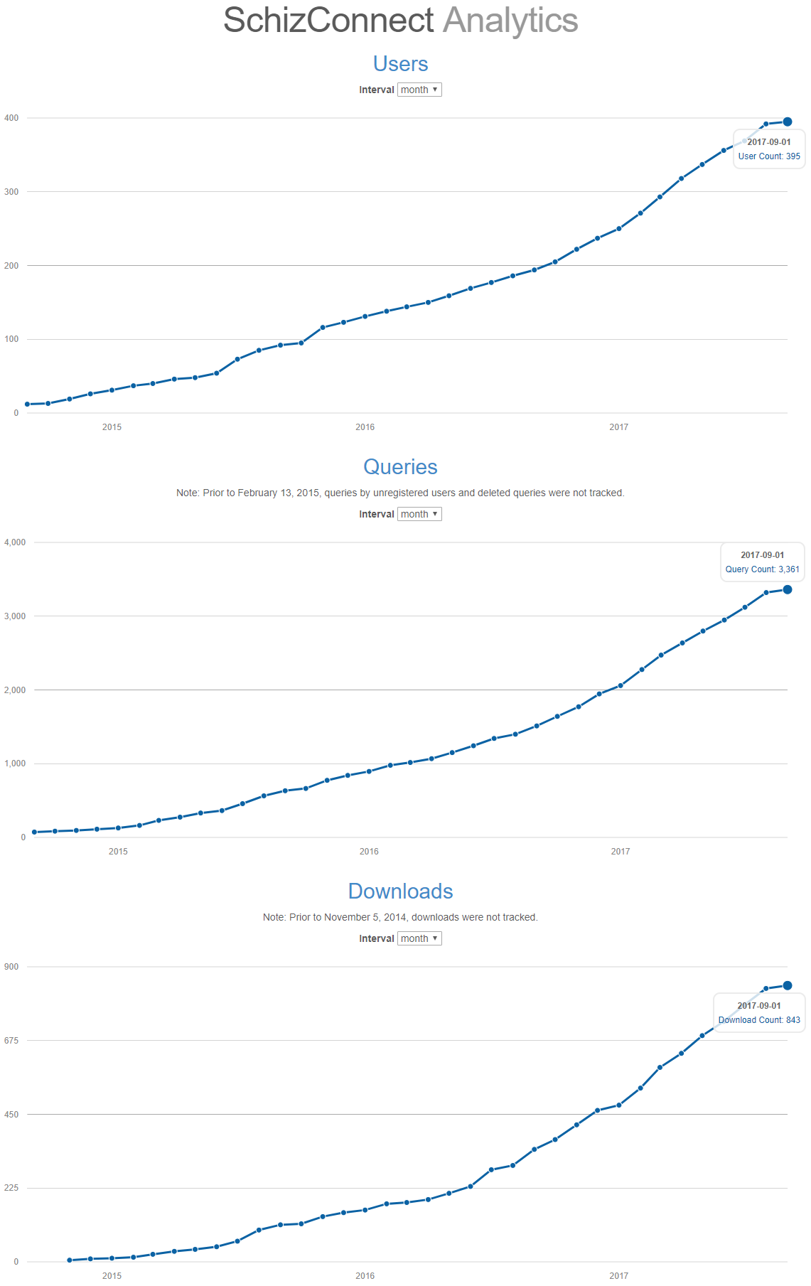
What is SchizConnect being used for
395 users, 3,361 queries, 843 downloads

Slide 22
What is SchizConnect being used for
395 users, 3,361 queries, 843 downloads
Hypothesis testing
  NIBIB BD2K R01 Neurodegenerative and Neurodevelopmental Subcortical Shape Diffeomorphometry (MPI: Miller, Paulsen, Mostfosky, Wang)
  Núñez, C., et. al (2017). Global brain asymmetry is increased in schizophrenia and related to avolition. Acta Psychiatrica Scandinavica. https://doi.org/10.1111/acps.12723
  Genetic study (Chakravarty)
Data discovery
  Service project for NIBIB P41 Center for Reproducible Neuroimaging Computation (CRNC) (PI: Kennedy)

Slide 23
What’s new at SchizConnect
New data sources
  FBIRN III, CNTRACS, REWARD, BrainGluSchi
Data standardization
  BIDS
Data computation
  Cloud – CERAMICCA (Beg)
  QA (Parrish), FSLDDMM (Beg), LiFE (Pestilli)
Data harmonization
  Automatic schema mapping (Ambite)
Data discovery
  DataBridge (Lander/Rajasekar)

Slide 24
New data sources
Currently 1200 subjects
Adding 980 subjects → Total = 2180 subjects
Central
●●●
FBIRN 3, CNTRACS, REWARD, BrainGluSchi

Slide 25

Data standardization – BIDS

Slide 26

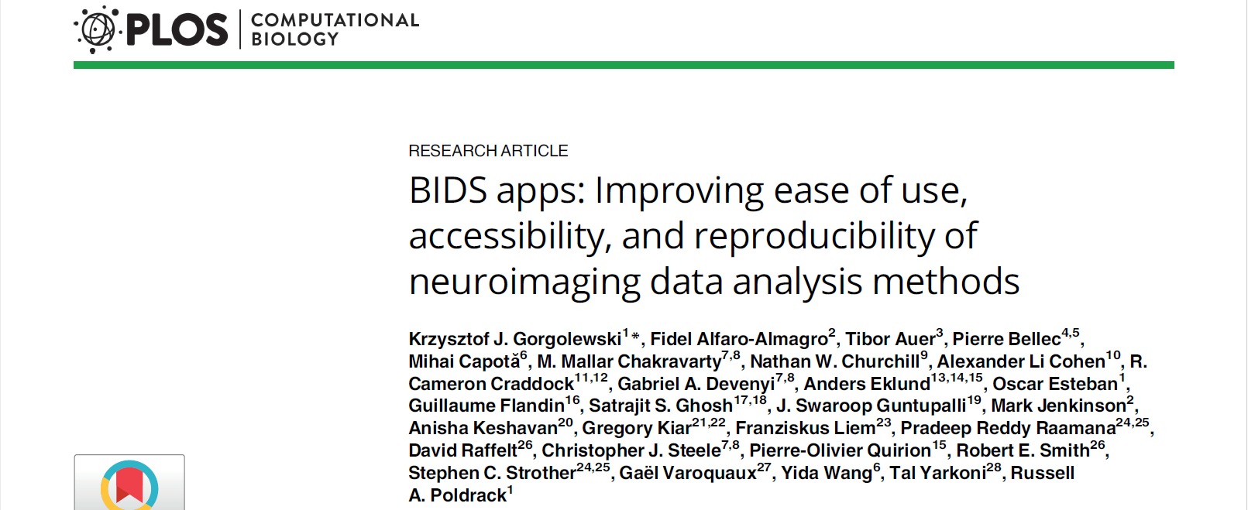
Data standardization – BIDS
Brain Imaging Data Structure (BIDS)
Chris Gorgolewski @ Stanford

Slide 27
Data standardization – BIDS
Simple, intuitive, standardized organization of neuroimaging data (images, behavior)
https://github.com/INCF/BIDS/blob/gh-pages/OHBM2016_poster.svg

Slide 28
Why BIDS for SchizConnect
Standardized file structure across data sources
Before BIDS …
COBRE/human/dicom/triotim/PI/cobre_ID/SUBID/SESID/TYPE/*.dcm
fBIRNPhaseII__0010/Data/SUBID/VISITID/EXAMTYPE/TYPE/Native/Original/NIFTI/*.img
MCICShare/SITEID/dicom/triotim/PI/mcicshare_ID/SUBID/SESID/TYPE/*.dcm
NMorphCH/NUNDA_ID/SESLABEL/scans/SCANID_TYPE/resources/DICOM/files/*.dcm
NUSDAST/CENTRAL_ID/SESLABEL/scans/SCANID/resouces/ANALYZE/files/*.img
Different file structure for each source
Required review of source-specific specification to understand
Onus on data source manager to keep documentation current
Pain for processing data

Slide 29
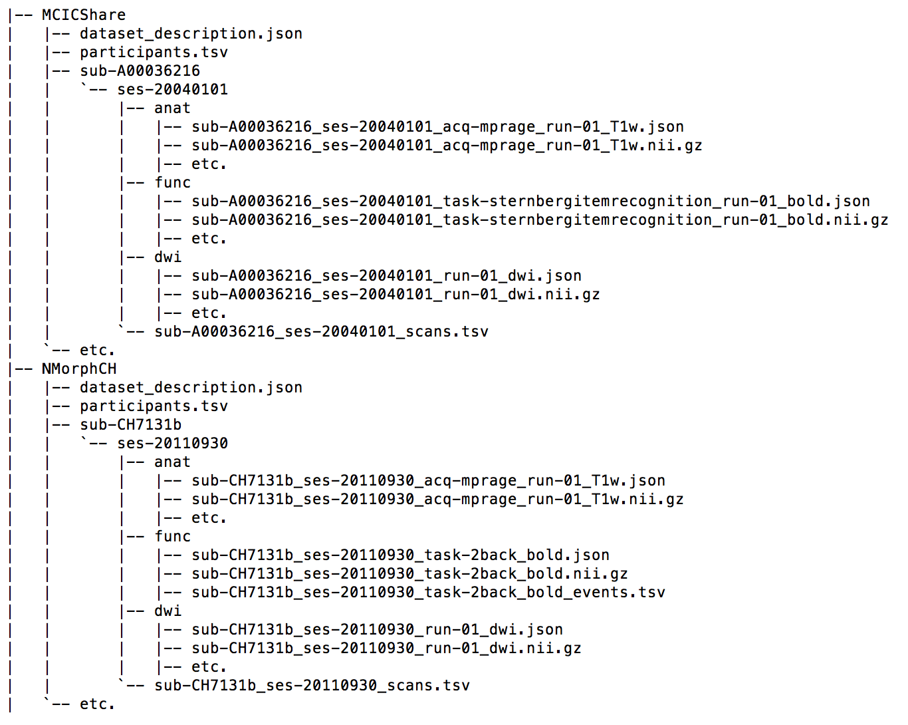
Why BIDS for SchizConnect
Standardized file structure across data sources
BIDS!
PROJECT/
sub-SUBJID/
ses-SESDATE/
DATATYPE/
sub-SUBJID_ses-SESDATE_IMGTYPE.nii.gz

Slide 30
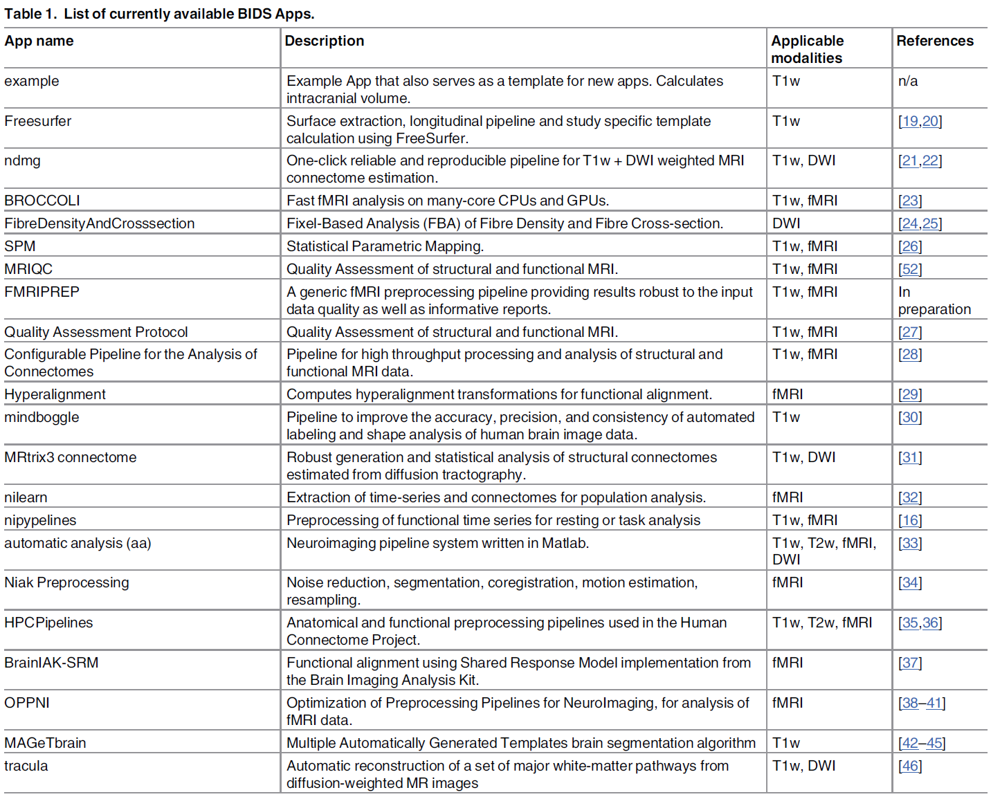
Why BIDS for SchizConnect
Standardized file structure across data sources
If you know BIDS specs, you can understand the data
BIDS apps

Slide 31
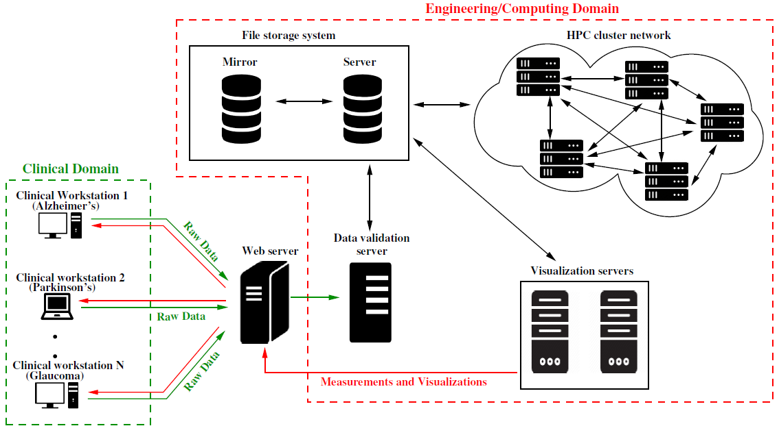
Data computation – CERAMICCA
Cloud Engine Resource for Accelerated Medical Image Computing for Clinical Applications
M. Faisal Beg @ Simon Fraser University
Web portal for secure, high-throughput pipeline on imaging databases
Leverages multiple HPC clusters, multiple HPC users in accordance with HPC regulations
Manages secure data upload, submission, transmission, processing, monitoring and cleanup from one central web-location
  Hiding the tedium and complexities of interacting with multiple HPC cluster environments

Slide 32
Data computation – CERAMICCA
5,000 T1 images downloaded from SchizConnect
Segment the hippocampus using FS+LDDMM with 100-atlas library
FS:
  5,000 8-hour jobs with a 500-job limit → 4 days of processing assuming user is able to (write a script to) submit new jobs once others complete
LDDMM:
  100 atlases for 5,000 targets → 500,000 jobs
  At 1 job, 500-job limit → 1,000 hours , or~ 42 days
  User needs to either login to HPC 1,000 times to launch jobs, or write a script to monitor jobs and submit new jobs
  User needs to check job status, resubmit jobs when they fail, which can happen on HPCs
    User needs to account for the dependent jobs during job fails
    Much more complex when using multiple HPC clusters

Slide 33
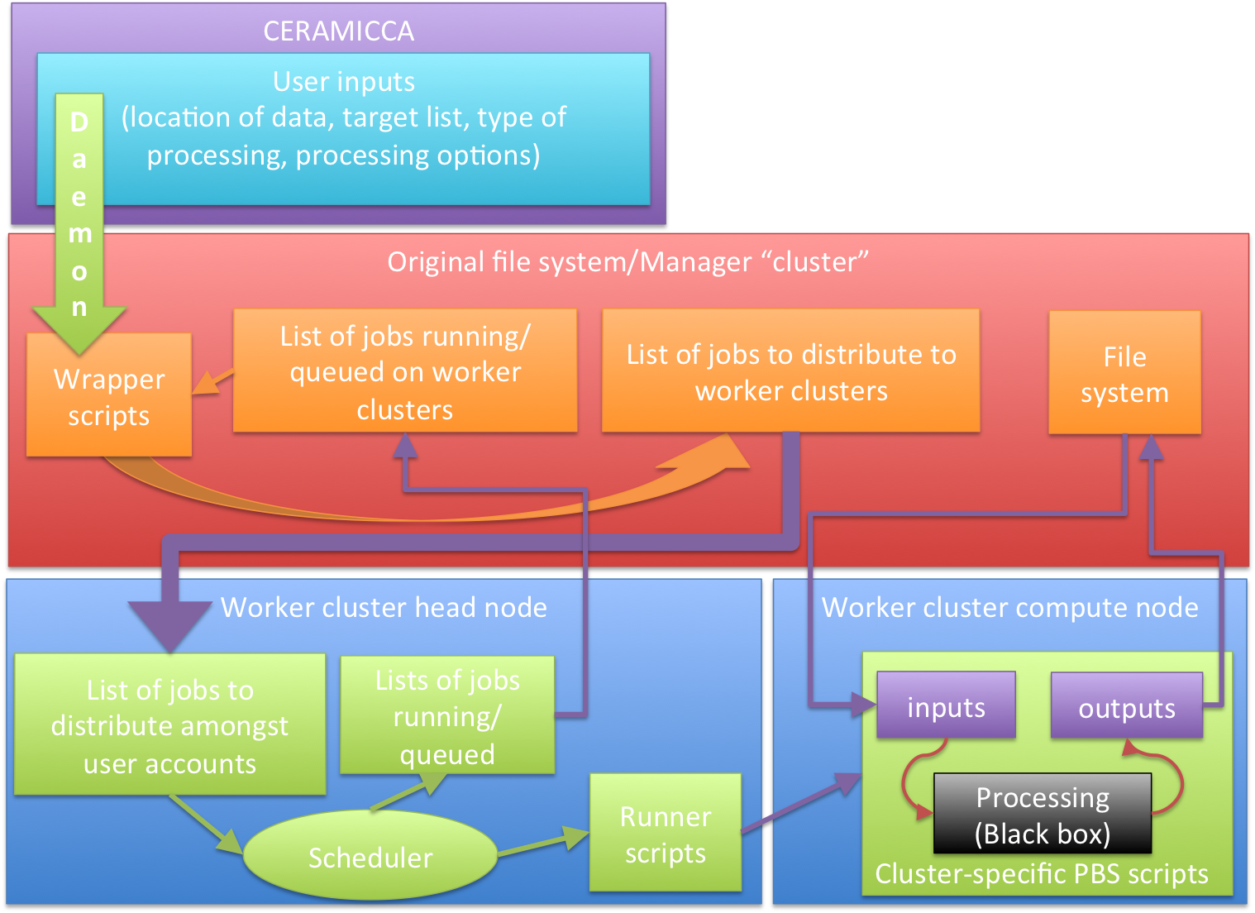
CERAMICCA meta-scheduler
Depends only on bash and cron, compatible with most HPC clusters
Processing routines are treated as a “black-box”
  Define inputs and outputs
  Ready for use with the meta-scheduler
No HPC?
  Globus access for collaborators

Slide 34
Data computation – CERAMICCA
5,000 T1 images downloaded from SchizConnect
Segment the hippocampus using FS+LDDMM with 100-atlas library
FS:
  5,000 8-hour jobs with a 500-job limit → 4 days of processing assuming user is able to (write a script to) submit new jobs once others complete
LDDMM:
  100 atlases for 5,000 targets → 500,000 jobs
  At 1 job, 500-job limit → 1,000 hours , or~ 42 days
  3 HPC clusters with 8 users each, meta-scheduler
  Completed in 3 days
  No manual action after the web form was submitted

Slide 35
Data harmonization
Automatic schema mapping via semantic similarity
Jose Luis Ambite, Joel Mathew @ USC
Mediator
Query rewriting
Source schemas/variables use idiosyncratically names
Unable to easily and automatically comparing values
Manual alignment is time-intensive and expensive
Need to automatically map schemas and combine/merge the observations from different studies
Common schemas
Central
Schema mapping
Source schemas
http://schizconnect.org/
●●●
Web Portal
Data Warehouse
Mediator Interface
Data Source Interface

Slide 36
Data harmonization
Automatic schema mapping via semantic similarity
Jose Luis Ambite, Joel Mathew @ USC
Match pairs of strings using
  Levenshtein Distance
  Word2Vec
  Sent2Vec
  Apache Lucene
Based on Java and C#
Validation against manual alignment

Slide 37
Data harmonization
Automatic schema mapping via semantic similarity
Jose Luis Ambite, Joel Mathew @ USC
Example: Matching SANS/SAPS from HID against data dictionaries of other studies in SchizConnect
Dataset | Variables
HID - SANS | 24
HID - SAPS | 33
MCIC | 106
NMORPH | 470
NUSDAST | 696
Gold Standard
Dataset | Variables in SANS | Variables in SAPS
MCIC | 4 | 4
NMORPH | 24 | 33
NUSDAST | 24 | 33

Slide 38
Data harmonization
SANS
Dataset | MCIC | NMORPH | NUSDAST
Precision Recall | 0.8 | 1 | 1
 | 1 | 1 | 0.958
Precision Recall | 0 | 0.957 | 0.875
 | 0 | 0.917 | 0.875
Precision Recall | 0.8 | 1 | 0.96
 | 1 | 1 | 0.96
Precision Recall | 0.8 | 1 | 1
 | 1 | 1 | 1
Precision Recall | 0.571 | 0.958 | 0.917
 | 1 | 0.958 | 0.917

Slide 39
Data harmonization
SAPS
Dataset | MCIC | NMORPH | NUSDAST
Precision Recall | 1 | 0.871 | 0.806
 | 1 | 0.818 | 0.758
Precision Recall | 0.333 | 0.758 | 0.667
 | 0.5 | 0.758 | 0.667
Precision Recall | 1 | 0.812 | 0.765
 | 1 | 0.765 | 0.765
Precision Recall | 0.8 | 0.758 | 0.818
 | 1 | 0.735 | 0.794
Precision Recall | 0.182 | 0.818 | 0.818
 | 1 | 0.818 | 0.818

Slide 40
Data discovery
DataBridge
Howard Lander, Arcot Rajasekar @ UNC
Males with Schizophrenia, both a DTI and a T1 scan, and measures of Executive Function
Central
●●●
FBIRN 3, CNTRACS, REWARD, BrainGluSchi
?

Slide 41
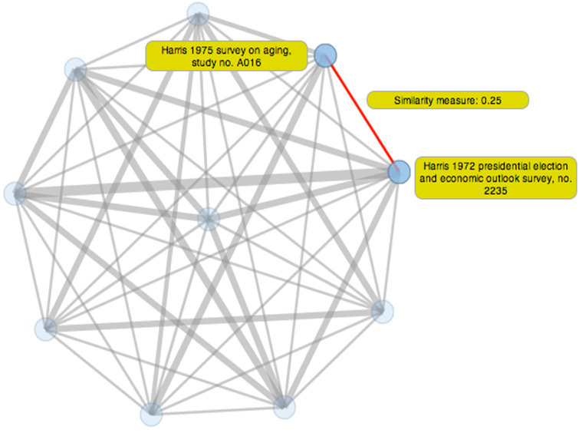
Data discovery
DataBridge
Assist scientists in discovering “interesting” data sets by automatically forming communities of data
Domain scientists can create their own algorithms defining “interesting”
Build an extensible, adaptable platform for building communities of data
Search for relevant data sets through community defined linkages

Slide 42
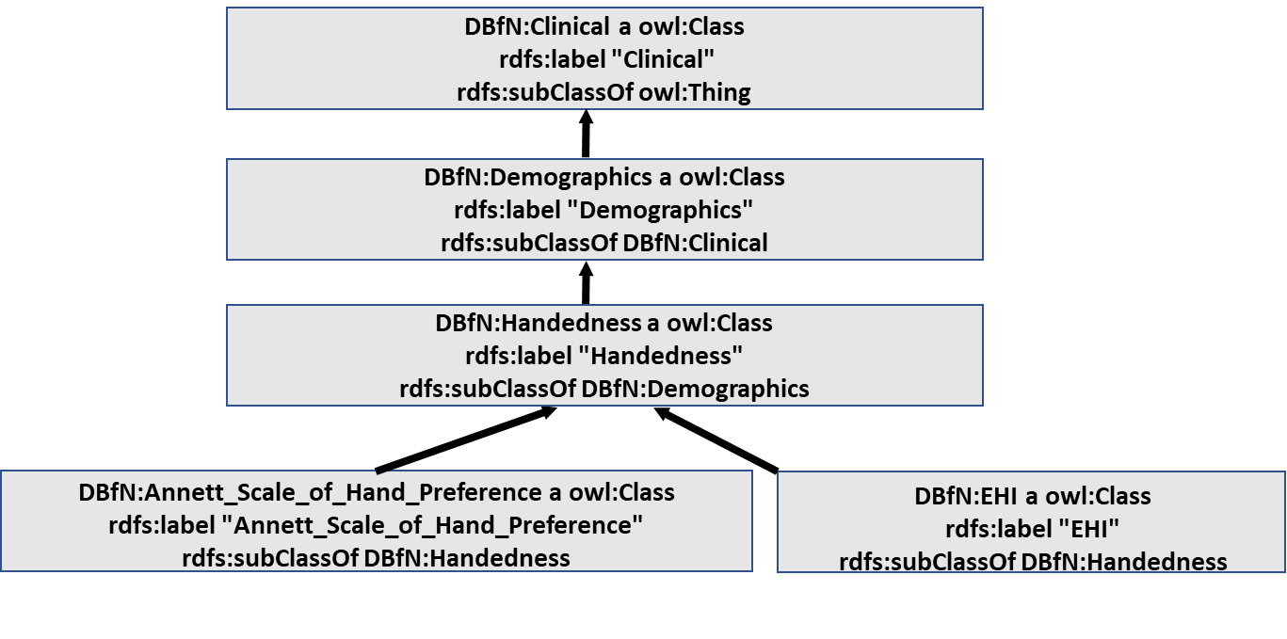
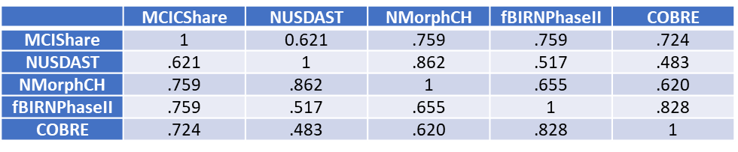
Data discovery
DataBridge
Similarity between SchizConnect datasets
Build resource description framework (RDF) of SchizConnect meta data and ontology
Use study metadata to define signature vectors
Hamming distance on signature vectors for similarity
Detect network of communities using the resulting set of similarities

Slide 43
Acknowledgements
NIMH 1U01 MH097435
SchizConnect team
  Jose Luis Ambite, Kathryn Alpert – mediator
  Steven Potkin, David Keator – FBIRN (HID)
  Vince Calhoun, Margaret King – MCIC, COBRE (COINS)
  Kathryn Alpert, Alex Kogan – NU (XNAT/REDCap)
  Jessica Turner – terminology
New at SchizConnect
  Deanna Barch, Juan Bustillo – new datasets
  Chris Gorgolewski, Kathryn Alpert – BIDS
  Karteek Popuri , Kathryn Alpert, M. Faisal Beg – CERAMICCA
  Jose Luis Ambite, Joel Mathew – schema mapping
  Howard Lander, Arcot Rajasekar – DataBridge

